Slide 1

PART 1 : DC ANALYSIS
Chapter 2 Basic Laws
2022.1

Slide 2
Main content of chapter 1
Definition of circuit variables：current,voltage,power
Definition of one kind of circuit elements: sources
Independent Voltage Sources,VCVS,CCVS
Independent Current Sources,CCCS,VCCS

Slide 3
Main content of chapter 2
Two basis for Circuit analysis：
(1) Voltage-current relationship of each element
sources(chapter 1),linear resistors(chapter 2)
(2) Kirchhoff’s Laws (chapter 2)
Note: if we are given a circuit, we can write equations about currents and voltages with above two basis, and then solve these equations to finish the process of circuit analysis.
2. Circuit Equivalent:
(1) subcircuit with sources (chapter 4)
(2) subcircuit with only resistors(chapter 2)
Note: if we are given a circuit, we can also consider first to simplify the circuit with circuit equivalent, and then solve the simplified circuit.
The main purpose to simplify the circuit first is to make the process of circuit analysis easier.

Slide 4
Chapter2 Basic Laws
2.1 Ohm’s Law and Linear Resistor.
2.2 Nodes, Branches, and Loops.
2.3 Kirchhoff’s Laws.
2.4 Equivalent Subcircuits.
2.5 Series Resistors and Voltage Division.
2.6 Parallel Resistors and Current Division.
2.7 Wye-Delta Transformations.
Two basis
the equivalence of subcircuit with only resistors

Slide 5
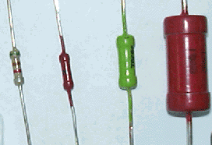
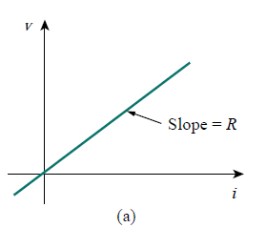
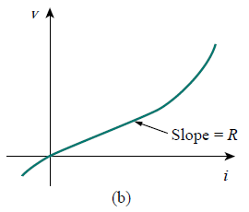
2.1 Ohm’s Law and Linear Resistor
The resistor is the simplest passive element.
An element which dissipates energy but stores none is said to consist solely of resistance.
u～i relations
(a) a linear resistor
(b) a nonlinear resistor
Figure 2.1

Slide 6

2.1 Ohm’s Law and Linear Resistor
Linear resistor
u～i relations
Ohm’s Law
u
u-i :A line through origin
i
u-i : Passive sign convention
i
R
+
u
－
R--Resistance ：Ω (Ohm)
in S.I. units
G –conductance: S (Siemens)

Slide 7
2.1 Ohm’s Law and Linear Resistor
Notice:
(1) u-i relationship for a linearity resistance
Ohm’s Law
(2) If passive sign convention
R
i
+
u
－
(3) If active sign convention
R
i
u = –R i
-
+
u

Slide 8
2.1 Ohm’s Law and Linear Resistor
Power of Resistance
(1) If passive sign convention
R
i
p_{absorbed} =ui= i²R=u²/R≥0
+
-
u
(2) If active sign convention
i
R
p_{absorbed} = –u i= –(–R i) i
= i²R= –u(–u/R)= u²/R≥0
-
u
+
Resistor always dissipates energy

Slide 9
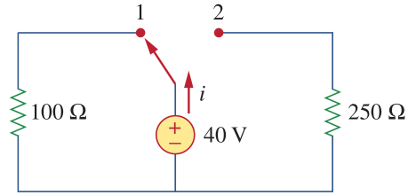
2.1 Ohm’s Law and Linear Resistor
Example:
Calculate the power absorbed by each circuit element when: (1) The switch is in position 1. (2) The switch is in position 2.
Solution:
Suppose u_{s}=40V
(1)method 1: p_{100Ω}=u_{s}²/100=16W
method 2: i=40/100=0.4A (ohm’s law)
p_{100Ω}=u_{s}i=16W, or p_{10Ω}=100i²=16W
p_{40V}=-u_{s}i=-16W(Source supplies power actually)
Figure 2.2
Note: (1)Normally, we calculate absorbed power for resistors and supplied power for sources.
(2)Normally, we select passive sign convention for passive elements, and active sign convention for active elements(sources)
(2)method 1: p_{250Ω}=u_{s}²/250=6.4W
method 2: i=40/250=0.16A (ohm’s law)
p_{10Ω}=u_{s}i=6.4W, or p_{10Ω}=250i²=6.4W
p_{40V}=-u_{s}i=-6.4W(Source supplies power actually)
9

Slide 10

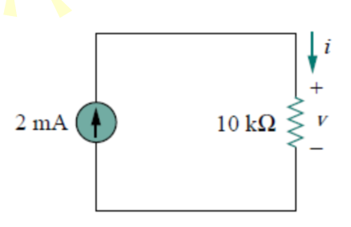
Multiple Choice(single)
Points: 1
Single choice
Please choose the voltage v and the power p absorbed by the resistor.
A
-20V, 40mW
B
-20V, -40mW
C
20V, 40mW
D
20V, -40mW
提交

Slide 11
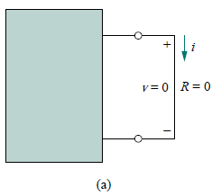

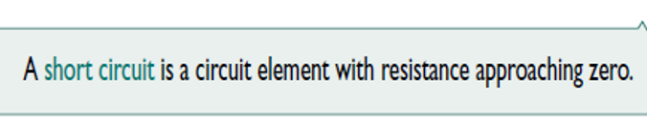
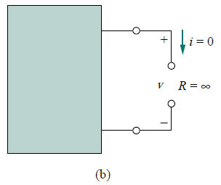

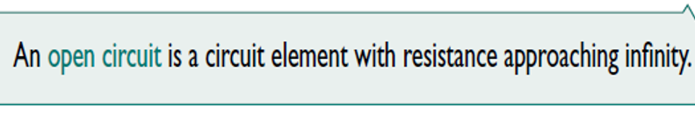
Two extreme possible values of R
An element with R = 0 is called a short circuit.
An element with R =∞ is known as an open circuit.

Slide 12
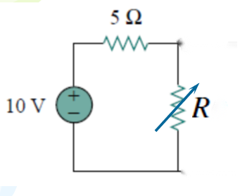
Practice: Please calculate the power absorbed by the resistor with the resistance of 5Ω when (1) R=0. (2)R=∞

Slide 13
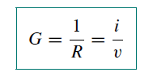
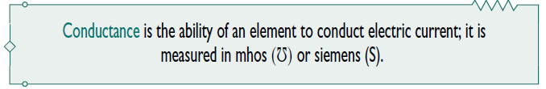

conductance
A useful quantity in circuit analysis is the reciprocal of resistance R, known as conductance and denoted by G:
The conductance is a measure of how well an element will conduct electric current.

Slide 14
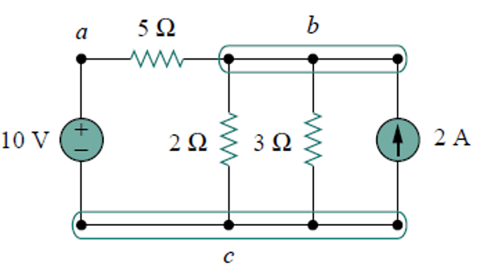
2.2 Branches and Loops , Nodes
Branch : A branch represents a single element such as a voltage source or a resistor.
Loop: A loop is any closed path in a circuit.
Node : A node is the point of connection
between two or more branches.
Node can be indicated in diagrams in two ways:
by a thin line enclosing the node, as with nodes b and c;
by marking a typical point within the node, as with node a.
Two or more elements are in series if they are cascaded or connected sequentially and consequently carry the same current.
Two or more elements are in parallel if they are connected to the same two nodes and consequently have the same voltage across them.
5 branches，3 nodes，6 loops

Slide 15
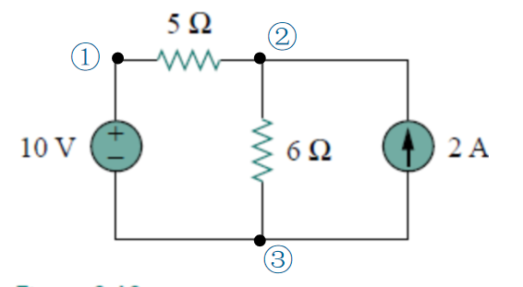
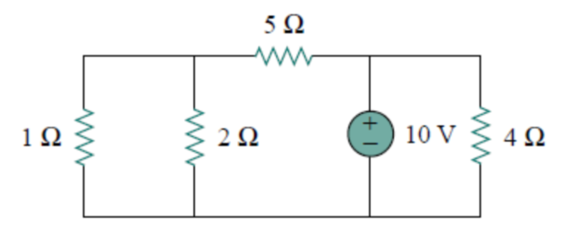
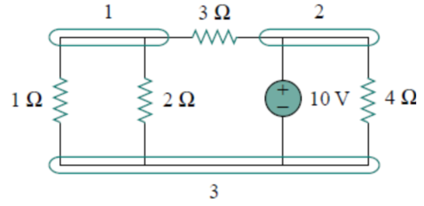
Practice
How many branches, nodes and loops are there?
Figure 2.3
Practice
How many branches and nodes does the circuit in Fig. 2.4 have? Identify the elements that are in series and in parallel.
Fig. 2.4

Slide 16
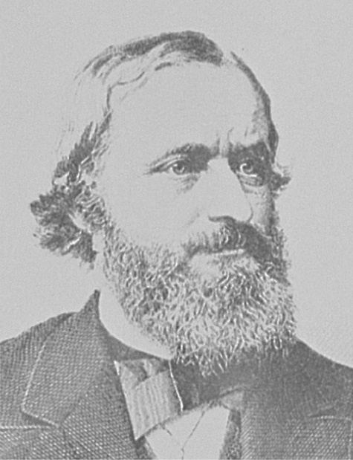
2.3 Kirchhoff’s Laws
Kirchhoff’s laws were first introduced in 1847 by the German physicist Gustav Robert Kirchhoff (1824–1887).
These laws are formally known as Kirchhoff’s current law (KCL) and Kirchhoff’s voltage law (KVL).
They are about the relationship of branch currents and branch voltages in an electrical network.

Slide 17
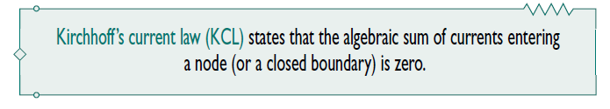
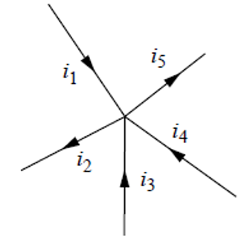
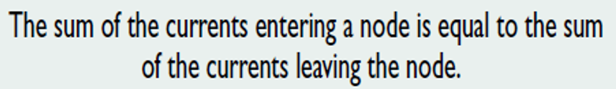
2.3 Kirchhoff’s Laws (1)
Mathematically, KCL implies that
Where N is the number of branches connected to the node, and i_{n} is the nth current entering the node .

Slide 18
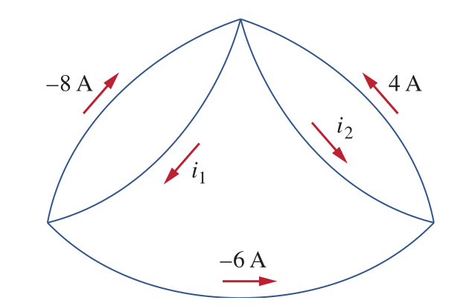
Practive: Determine i₁ and i₂ in the following circuit.
i₁= A ; i₂ = A.

Slide 19
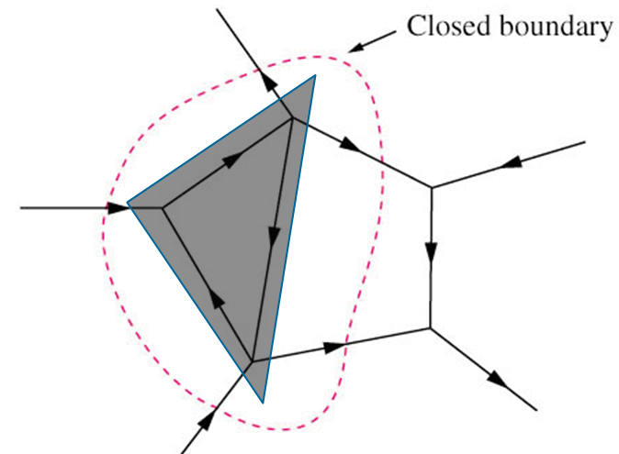





Supernode: a closed boundary.
Note: KCL also works for a supernode.
Node 1: i₁+i₂+i₇-i₆=0
(Super node)
i₆
①
Node 2: i₃-i₄+i₈-i₇=0
Node 3: -i₅+i₆-i₈=0
i₇
③
i₈
For the supernode:
i₁+i₂+i₃-i₄-i₅=0
②

Slide 20
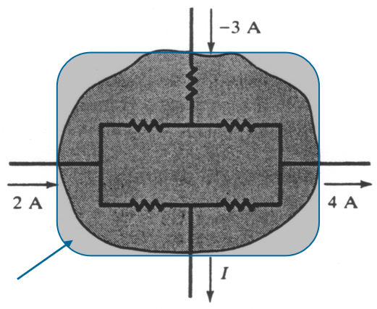
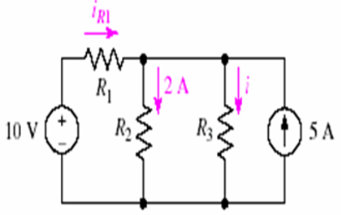
Example: Determine the current I for the circuit shown in figure 2.5.
For the supernode:
I + 4-(-3)-2 = 0 I = -5A
Fig. 2.5
Example:For the circuit in Fig. 2.6, compute the current through resistor R₃ if it is known that the voltage source supplies a current of 3 A.
i_{R1} － 2 － i ＋ 5 = 0
i_{R1} = 3
So i = 6A
Fig. 2.6

Slide 21
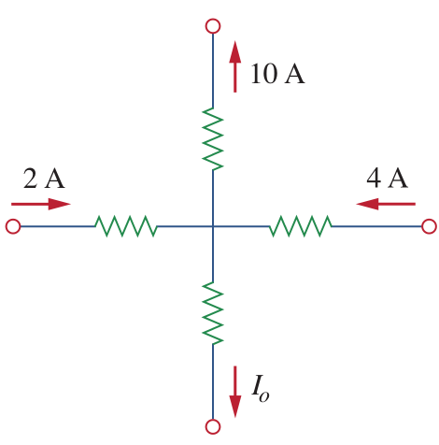
Multiple Choice(single)
Points: 1
The current of I₀ is
A
-4A
B
-2A
C
4A
D
16A
提交

Slide 22
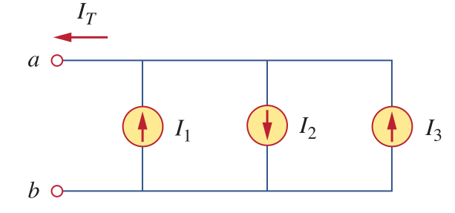
Multiple Choice(single)
Points: 1
Single selection.
In the circuit, I_{T} equals to
A
I₂-I₁-I₃
B
-I₂+I₁+I₃
C
I₂-I₁+I₃
D
-I₂+I₁+I₃
提交

Slide 23
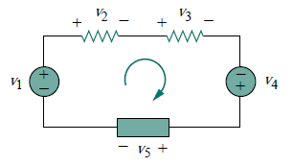



2.3 Kirchhoff’s Laws (2)
Mathematically, KVL implies that
loop direction: clockwise or counterclockwise

Slide 24
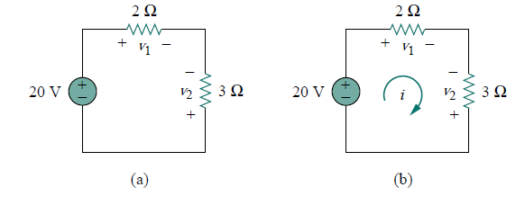
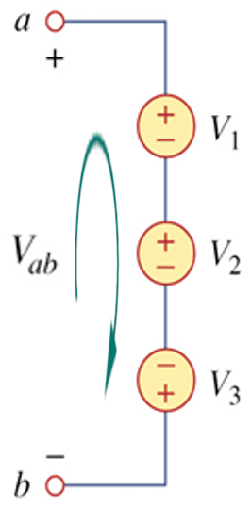
Example:Determine the
voltage v_{ab} in Fig. 2.7.
Example:For the circuit in Fig. 2.8(a), find voltages v₁ and v₂.
Figure 2.8
How to write equations up to now?
Answer：by ohm’s law, KCL, KVL
Figure 2.7
Solution:
By applying KVL , we obtain
Solution:suppose the current is i
Applying Ohm’s law：
v₁=2i, v₂=-3i
So
Applying KVL：
v₁=20+v₂
So v₁= 8V, v₂= -12V

Slide 25
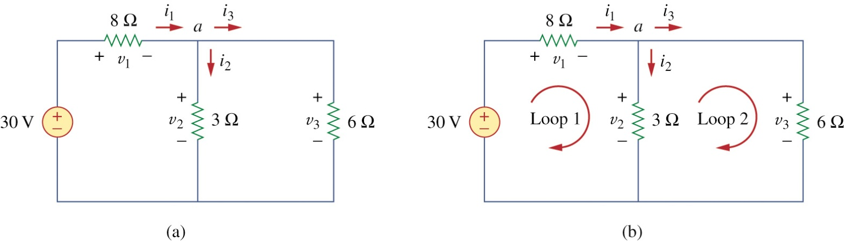
Example：Find the currents and voltages in the circuit shown in Fig. 2.9(a).
Figure 2.9
Solution
Apply Ohm’s law: v₁ = 8i₁, v₂ = 3i₂, v₃ = 6i₃
Apply KCL: i₁ – i₂ – i₃ = 0
Applying KVL:v₁ + v₂ =30，v₂ = v₃
So i₁ =3A , i₂ = 2A, i₃ = 1A, v₁ = 24V, v₂ = 6V, v₃ =6V

Slide 26
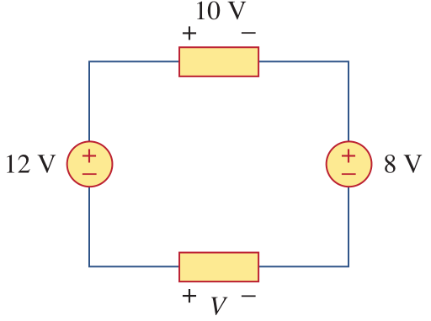
Multiple Choice(single)
Points: 1
In the circuit, V is:
A
30V
B
14V
C
6V
D
10V
提交

Slide 27
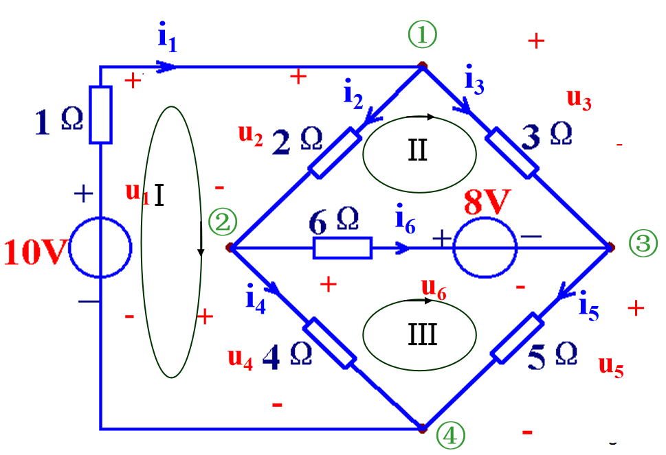
Independent node and Independent loop
4 nodes,6 branches,7 loops
KCL based equations:
Node 1:
Node 2:
Node 3:
Node 4:
3 independent equations
we say 3 independent nodes
n nodes n-1 independent nodes
Note: (1) nodes corresponding to independent KCL equations are called independent nodes.
(2) node corresponding to dependent KCL equation is dependent node,or reference node.
(3) n nodes in a circuit n-1 independent nodes,1 reference node.
(4) Normally one node is selected as reference node, and the left n-1 are independent nodes.

Slide 28
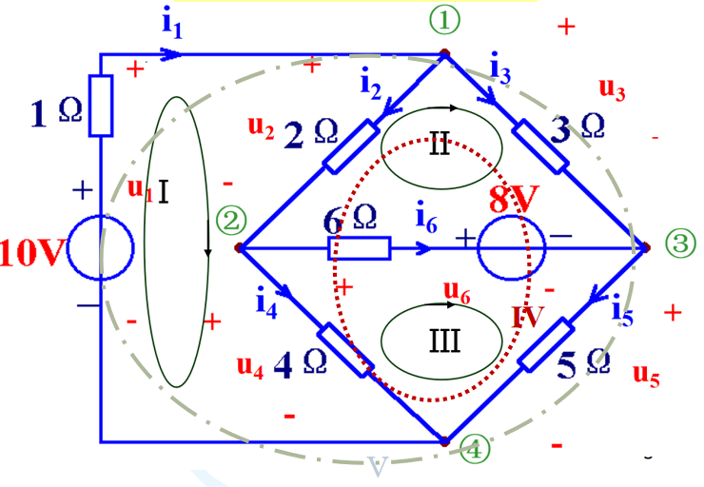
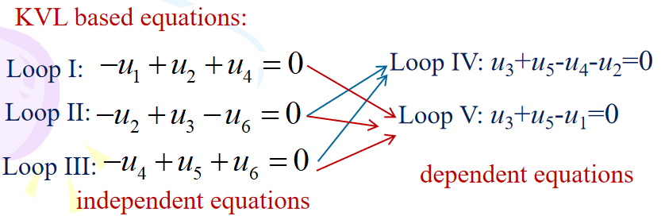
Independent node and Independent loop
4 nodes,6 branches,7 loops
3 meshes
number independent loops=number of meshes
Note: (1) loops corresponding to independent KVL equations are called independent loops.
(2) loops corresponding to dependent KVL equations are called dependent loops.
(3) number of independent loops = number of meshes.
(4) How to write independent KVL equations?
method 1: choose meshes,and then write KVL equations for each mesh.
method 2: step 1, select one loop and write KVL equation; step 2, select another loop which contains at least one new branch and write KVL equation; repeat step 2 until you have write all independent equations. (number of independent loops = number of meshes)
KCL equations for 4 nodes:
Node A: i1-i2-I0=0
Node B: i1-i2-I0=0

Slide 29
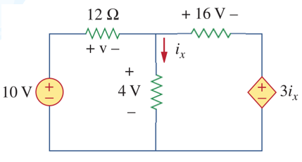
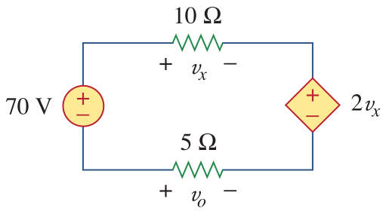
Homework （3th time）
1. Calculate the absorbed power of each resistor and the supplied power of each source in the circuit.
2. Find and in the following circuit.

Slide 30

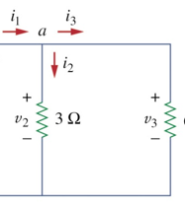
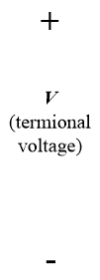
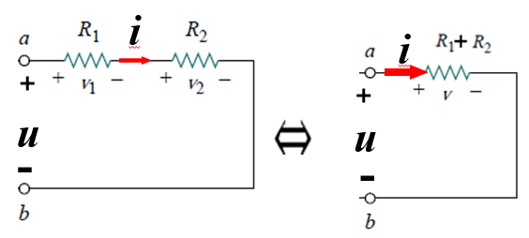


2.4 Equivalent Subcircuits
1. Some concepts
terminal law : the voltage-current relationship of a
two-terminal subcircuit.
v = f(i) or i = g(v)
Equivalent subcircuits: Two two-terminal subcircuit are said to be equivalent if they have same terminal law.

Slide 31
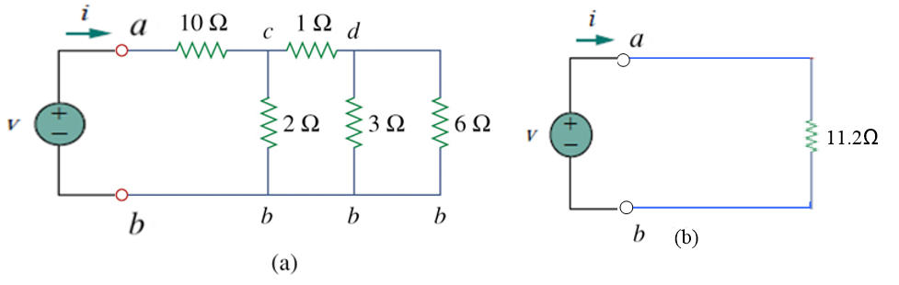

2.4 Equivalent Subcircuits
1. Some concepts
Why equivalent subcircuits?
A generally useful strategy in analyzing electric circuits is to simplify wherever possible.
-Replacing a part of a circuit with a simple equivalent subcircuit contains fewer elements, without altering any current or voltage outside that part ( or region).
-The simpler circuit can then be analyzed, and the results will apply equally to the original, more complex, circuit.
We can get same v,I with both circuit!

Slide 32
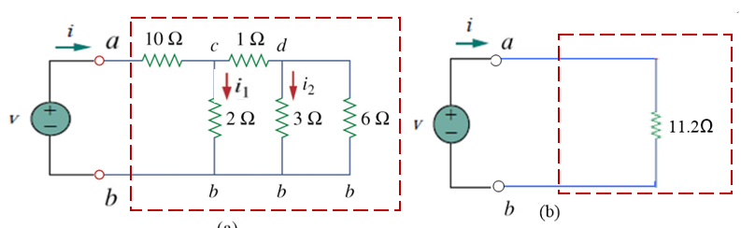

2.4 Equivalent Subcircuits
2. Attention to external and internal part of equivalent subcircuit
Attention: Only the currents and voltages external to the equivalent subcircuit will not be changed when one is exchanged for the other in any circuit; the currents and voltages internal to the subcircuit may be quite different.
internal
external
internal
external
Through circuit equivalence，we can compute i , but could not compute i₁ ot i₂！！！

Slide 33
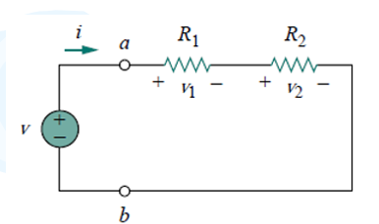
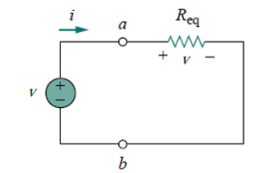


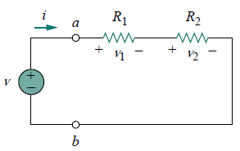




2.5 Series Resistors and Voltage Division
Series: Two or more elements are in series if they are cascaded or connected sequentially and consequently carry the same current.
principle of voltage division

Slide 34
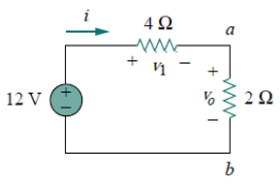
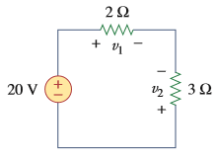




2.5 Series Resistors and Voltage Division
In general, if N resistors (R₁,R₂, . . . , R_{N}) in series with the source voltage v, the nth resistor (R_{n}) will have a voltage drop of

Slide 35
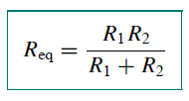
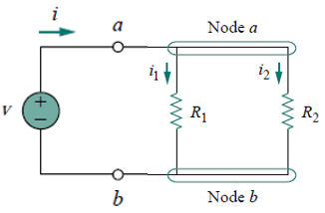
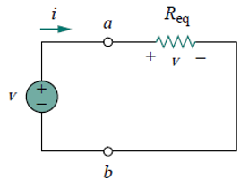


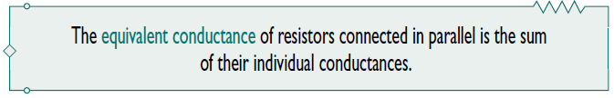
2.6 Parallel Resistors and Current Division (1)
Parallel: Two or more elements are in parallel if they are connected to the same two nodes and consequently have the same voltage across them.
The equivalent resistance of a circuit with N resistors in parallel is:

Slide 36












principle of current division
current divider
Notice：the larger current flows through the smaller resistance.
The total current i is shared by the resistors in inverse proportion to their resistances. The current divider can be expressed as:

Slide 37



Parallel Resistors and Current Division ---- an extreme case 1

Slide 38







Example: Find R_{eq} for the circuit shown in the following circuit.
⇒
⇒
R_{eq}=14.4Ω

Slide 39





Practice:By combining the resistors, find R_{eq.}
⇒
⇒
⇒
Ans: 6Ω

Slide 40








Example Calculate the equivalent resistance R_{ab} .
⇒
⇒
⇒
⇒
R_{ab}=11.2 Ω

Slide 41







Practice Find R_{ab} for the circuit.
⇒
⇒
⇒
⇒

Slide 42










Example：Find i₀ and v₀ in the circuit，and calculate the power dissipated in the 3-Ω resistor.
Solution1
Solution2
⇒
or

Slide 43








Example：For the circuit, determine: (a) the voltage v_{o}, (b)the power supplied by the current source, (c) the power absorbed by each resistor.
Solution：
So
43

Slide 44



2.7 Wye-Delta Transformations
There are some situations while the resistors are neither in parallel nor in series. How to simplify them? Many circuits of the type shown left can be simpliﬁed by using three-terminal equivalent networks.
Our main interest: how to identify them when they occur as part of a network; how to apply wye-delta transformation in the analysis of that network.
Two forms of the same network: (a) Y, (b) T.
Two forms of the same network: (a)Δ, (b) Π.

Slide 45


Example:Find the Δ construction and Y construction in the following circuit.
Δ construction:

Slide 46
Example:Find the Δ construction and Y construction in the following circuit.
Y construction:

Slide 47



Delta -> Wye
rules: Each resistor in the Y network is the product of the resistors in the two adjacent Δbranches, divided by the sum of the three Δ resistors.
47

Slide 48










Example:Convert the Δ network to an equivalent Y network.
Delta -> Wye steps :
Keep node a,b,c unchanged.
2. Add node n.
3. Add 3 branches.
4. Compute resistances.

Slide 49








Example:Obtain the equivalent resistance R_{ab} for the circuit and use it to find current i.
Solution:
Delta -> Wye
⇒

Slide 50

Wye -> Delta
Rule: Each resistor in the Δnetwork is the sum of all possible products of Y resistors taken two at time, divided by the opposite Y resistor.
50

Slide 51




Example:Convert Wye network to an equivalent Delta network.
a
a
Wye -> Delta steps :
Delete node n.
delete branches of Wye network.
Add 3 branches.
Compute resistances.
c
n
c
n
b
b

Slide 52
Example:Convert Wye network to an equivalent Delta network.
Wye -> Delta steps :
Delete node n.
a
2. delete branches of Wye network.
3. Add 3 branches.
c
n
a
4. Compute resistances.
b
c
n
b

Slide 53
If R₁=R₂=R₃=R_{Y} and R_{a}=R_{b}=R_{c}=R_{Δ}, the Y and Δ networks are said to be balanced
Under these conditions, conversion formulas become

Slide 54








Example:Obtain the equivalent resistance R_{ab} for the circuit, and use it to calculate current i.
Y construction

Slide 55




Example:Obtain the equivalent resistance R_{ab} for the circuit, and use it to calculate current i.

Slide 56

Practice For the bridge network,find R_{ab} and i.

Slide 57


Summary and Review
For a linear resistor:
Ohm’s law The power dissipated
Passive sign condition: v = i R p = v i = i²R = v²/R
Active sign condition: v = -i R p =- v i = i²R =v²/R
Kirchhoff’s laws:
KCL:
KVL:

Slide 58
Summary and Review
in series :All elements in a circuit that carry the same current are said to be connected in series.
A series combination of N resistors can be replaced by a single resistor having the value
R_{eq}＝R₁+R₂+…+R_{N}. Voltage division
in parallel :Elements in a circuit having a common voltage across them are said to be connected in parallel.
A parallel combination of N resistors can be replaced by a single resistor having the value
Current division

Slide 59


Homework （4th time）
1. For the circuit, i₀=3A,Calculate i_{x} and the total power absorbed by the entire circuit.
2. Find R_{eq} and i₀ in the circuit.

Slide 60



3. For the circuits , obtain the equivalent resistance at terminals a-b.
(a) (b)
(c)

Slide 61

4. Obtain the equivalent resistance at the terminals a-b for each of the circuits.

